Slide 1


Slide 2
TEAM 3
When Students Move To A New School, They Sometimes Face Problems. How Can Schools Help These Students With Their Problems?
MEMBERS
Voeun Sreyvoath
Choan Chorn
Chhun SengHak

Slide 3
TABLE CONTENT

1
Students’ Problems
2
School Solutions For Student
3
Conclusion

Slide 4




1
Students’ Problems
Meet new
people
Peer factors and discrimination
Mental health
Financial

Slide 5

Meet New People

Slide 6

Peer Actors And Discrimination

Slide 7
Mental Health

Slide 8

Financecial Problem

Slide 9

2
School Solutions For Students
Orientation Programs
Peers Mentoring
Inclusion Initiatives
Counseling Services
Academic Support
Parents Involvement

Slide 10
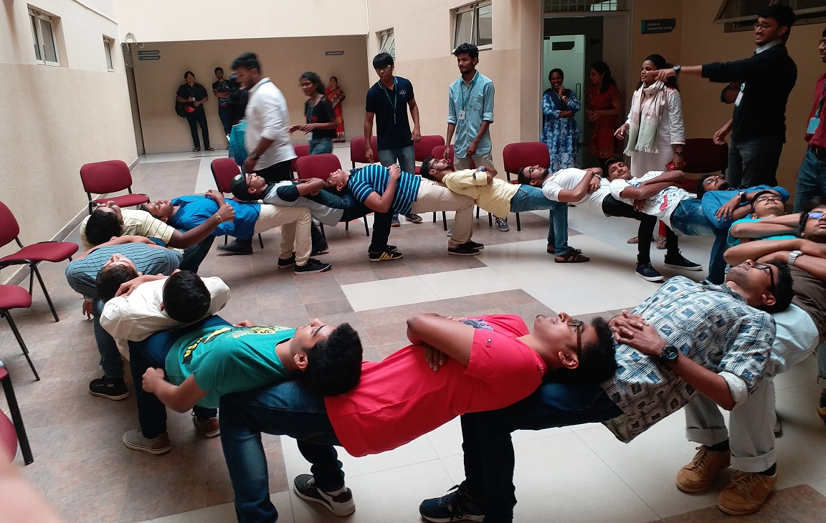
Orientation Programs

Slide 11

Peer Mentoring

Slide 12

Counseling Services

Slide 13

Inclusion Initiatives

Slide 14

Parents Involvement

Slide 15
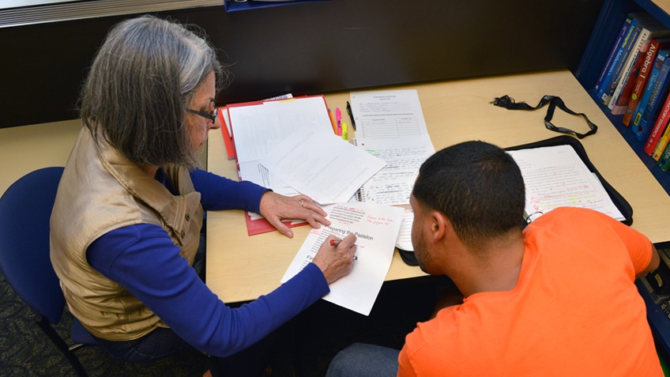
Academic Support

Slide 16
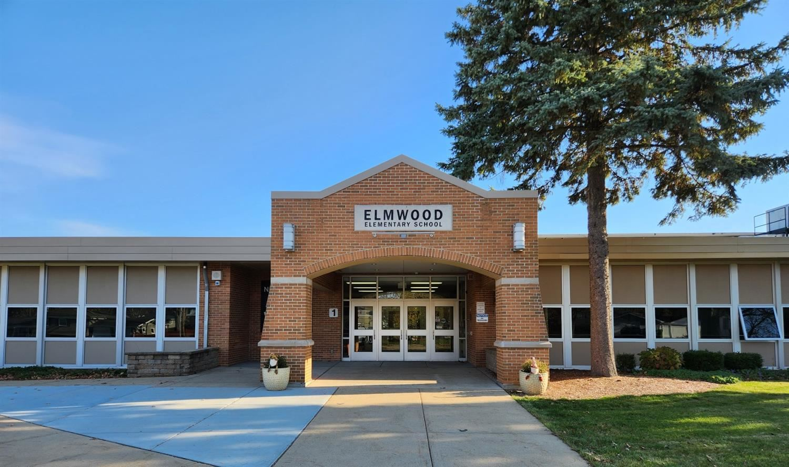
3
CONCLUSION

Slide 17

Q & A

Slide 18

THANK YOU

